Slide 1








CREATIVE AI STORY GENERATOR: AN INTERACTIVE STORY GENERATING PLATFORM
Team
Mentor : Dr P.Geetha
Asvajith B
Muthukumaran S
Gokulakrishnan E

Slide 2
INTRODUCTION
Creative AI Storytelleris an interactive platform designed to spark creativity in children by allowing them to generate personalized stories and images based on simple prompts. Powered by a fine-tuned GPT-2 model for story generation and the Gemini API for image creation, the platform encourages imaginative exploration. Users can input themes or characters, and the system generates dynamic stories and visuals
Key Features:
AI-Powered Story Generation
Image Generation:

Slide 3
PROBLEM DEFINITION
Children often engage with static entertainment like books or videos, limiting creativity and involvement. There’s a need for interactive platforms that foster imagination by allowing children to create personalized stories and visuals. Existing options lack customization, preventing unique content generation.

Slide 4
OBJECTIVE
Encourage Creativity: Provide an interactive platform for children to generate personalized stories and images based on their own prompts
User-Friendly Design: Build a simple, intuitive interface that allows easy navigation for children, including features like login, history management, and story playback
.Educational Value: Use AI to foster creative thinking, storytelling skills, and imaginative exploration in a fun and educational way.

Slide 5
SURVEYS
Storytelling and Literacy Development
Journal of Research in Childhood Education found that listening to stories can improve children's vocabulary,
The Role of Story Listening in Cognitive Development
National Association for the Education of Young Children (NAEYC) emphasizes that listening to stories fosters cognitive skills like memory, attention, and critical thinking.

Slide 6
SYSTEM ARCHITECTURE
Frontend (React.js) User Interface:
Login/Register Pages:Enables user authentication and session management.
Prompt Input: Simple text field where users input prompts to generate stories and images.
History Page:Displays previously generated stories, retrieved from local storage.
Local Storage (React feature)User History Management: User-generated stories and associated images are stored in the browser’s local storage, allowing users to access their story history without requiring server-side storage.
Flask API Layer
RESTful APIs: The Flask backend handles API requests from the frontend (for generating stories and images) and sends back the responses to the React frontend.

Slide 7
SYSTEM ARCHETECURE
Backend (Flask Framework)GPT-2 Story Generation:The backend receives user prompts through API requests and processes them using a fine-tuned GPT-2 model for generating personalized stories
.GPT-2 has been trained on children’s story datasets, enhancing its capability to generate child-friendly content.Gemini API for Image Generation:When a prompt is entered, the backend interacts with the Gemini API, generating corresponding images that match the theme of the generated story.
Audio Feature (TTS)Text-to-Speech (TTS): A TTS module converts the generated story into an audio format, allowing children to listen to the story instead of reading it.

Slide 8
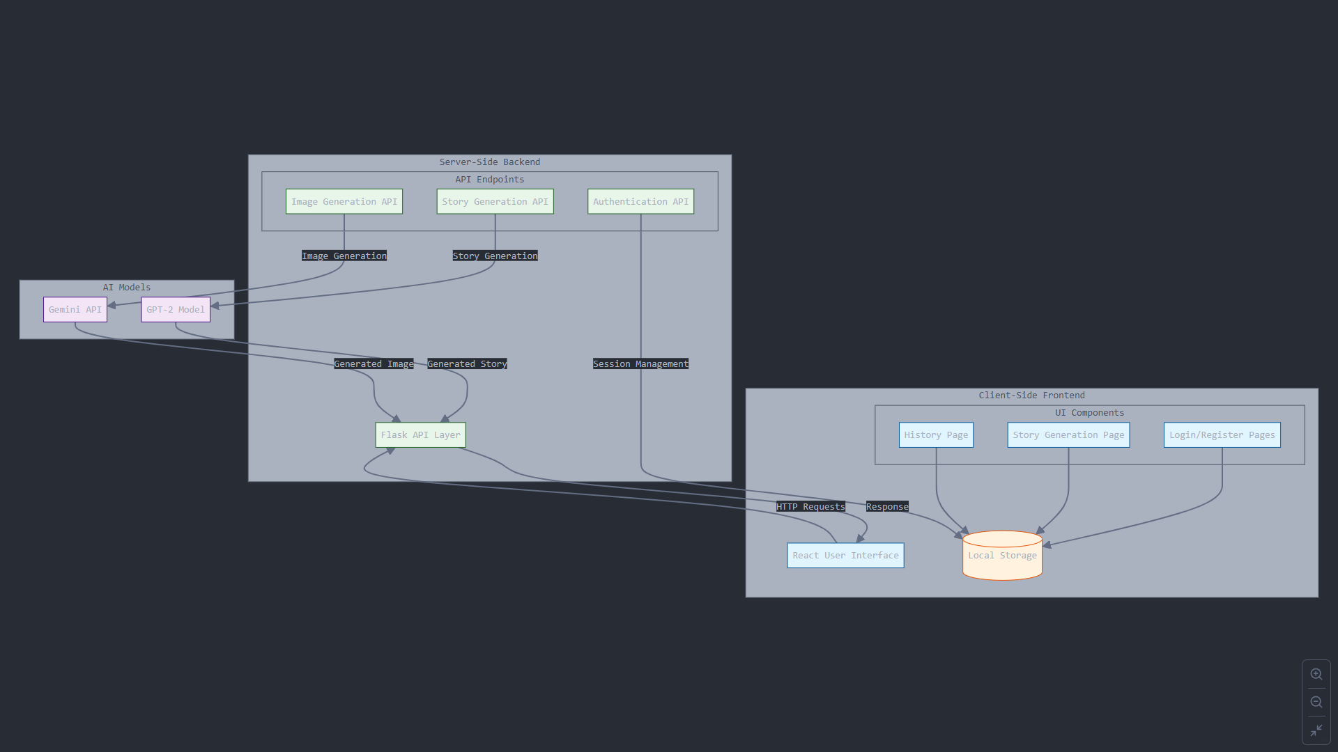
SYSTEM ARCHITECTURE

Slide 9
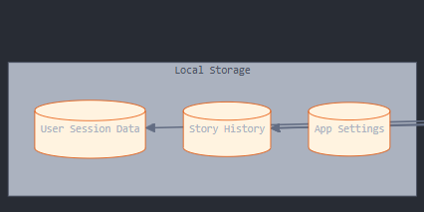
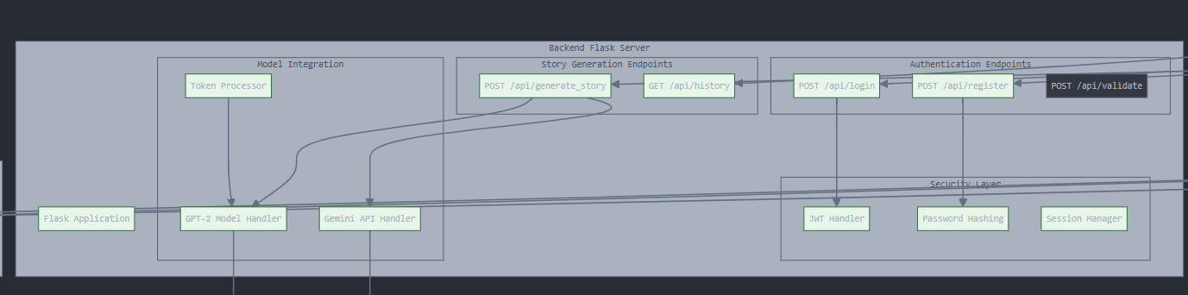
DETAILED DESIGN

Slide 10
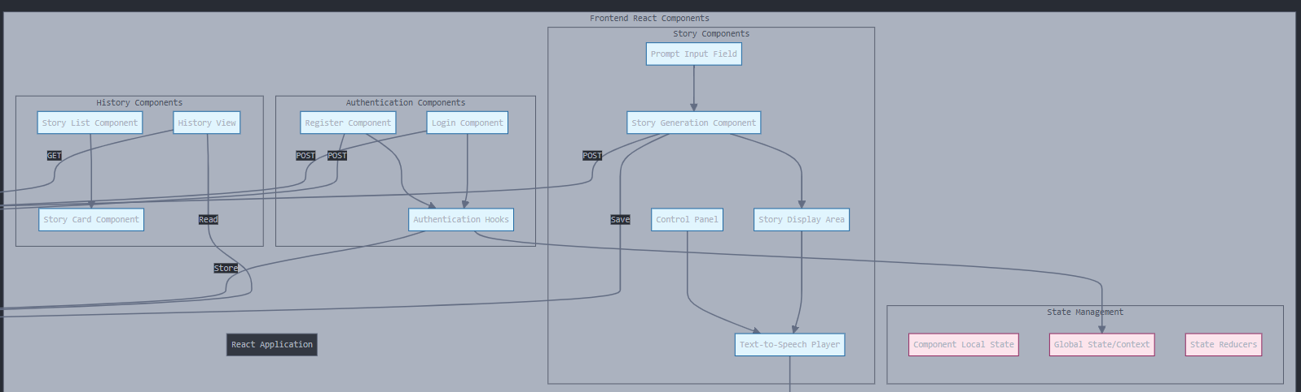

Slide 11
DETAILED DESIGN
1. Frontend Design (React.js)
- User Interface Components:
Login/Register Component: Form for username and password input with validation.
Story Generation Component: Input field for prompts, "Generate" button, and displays the generated story and image. Includes copy and text-to-speech options.
History Component: Shows past stories from local storage, with options to view or delete.
State Management:** Uses React hooks (`useState`, `useEffect`) for local state; optional Context API or Redux for global state.

Slide 12
. Backend Design
API Endpoints:
POST /api/login: Authenticates users and returns session tokens.
POST /api/register: Handles user registration and securely stores data.
POST /api/generate_story: Accepts prompts, generates stories and images using the GPT-2 model and Gemini API, then returns results.
GET /api/history: Retrieves user story history.
AI Model Integration:
Connects GPT-2 for story generation and the Gemini API for image creation
Audio Feature (Text-to-Speech)
Integrates a text-to-speech library to convert story text to audio with playback controls.

Slide 13
TOOLS AND TECHNOLOGIES
Frontend Tools:
React.js
HTML/CSS
JavaScript
Text-to-Speech Library (e.g., speechSynthesis)
Backend Tools:
Database and Storage:
Local Storage
Python - Flask
GPT-2 Model
Gemini API

Slide 14
RESULT
Story Generation: The application successfully generates stories based on user prompts, allowing for personalized and engaging narratives tailored to individual input.
Image Generation: Corresponding images are generated relevant to the user's prompts, enhancing the storytelling experience with visual elements.
Generation Speed: On average, the application takes approximately 3-4 minutes to generate a complete story and its associated image, balancing quality and responsiveness.

Slide 15
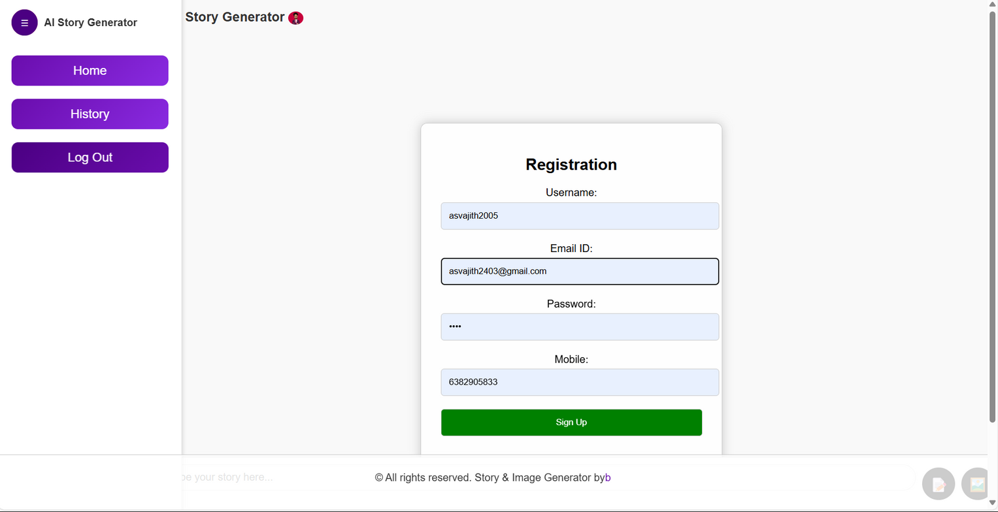

Slide 16
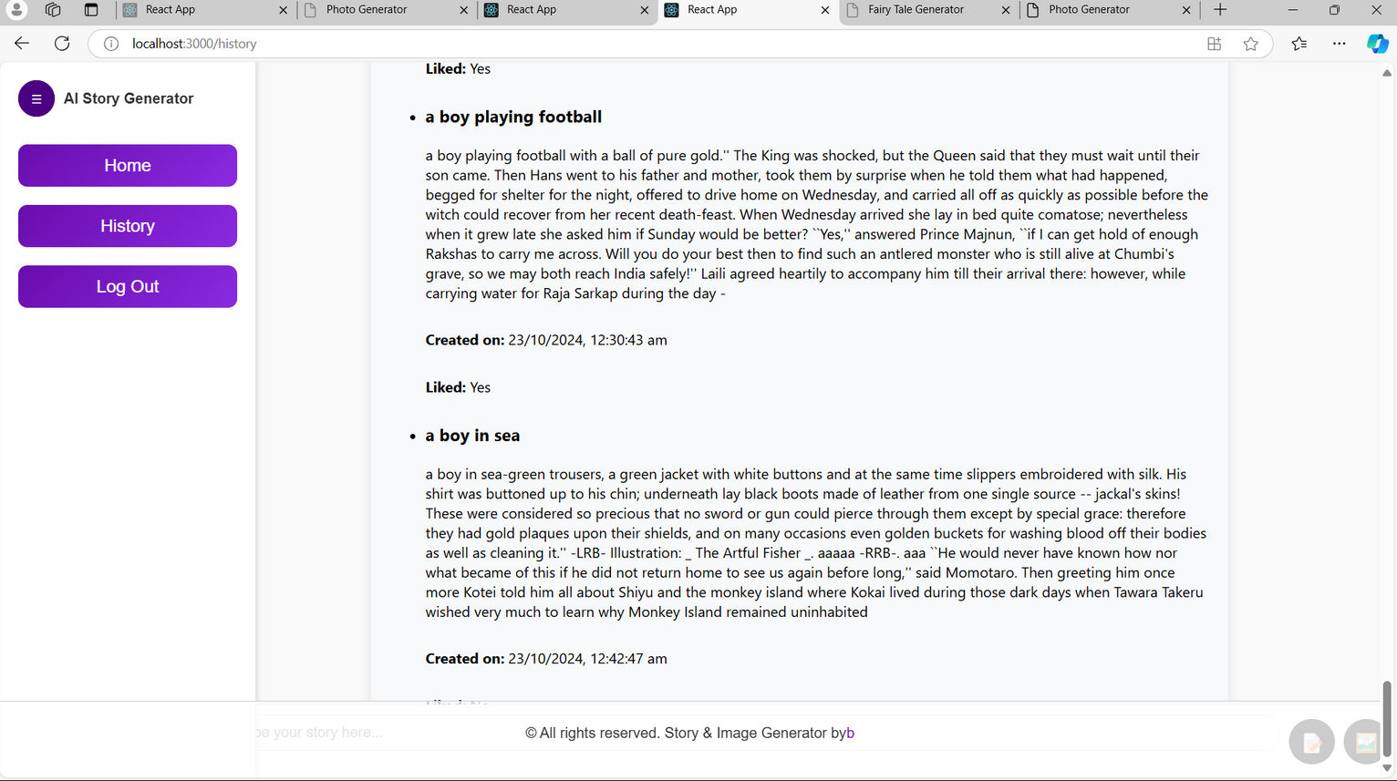

Slide 17
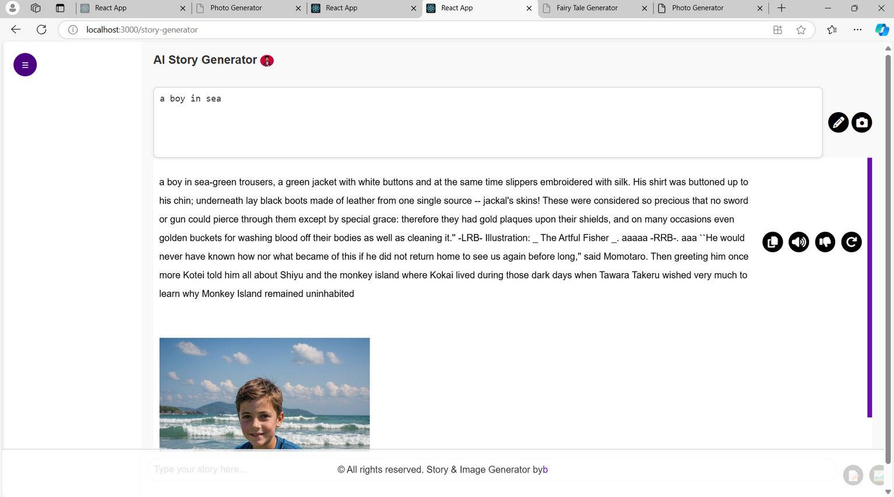

Slide 18
